Slide 1
Twice as nice?
A Longitudinal Field Study of Separate vs. Combined Nudges for Household Laundry Behaviours

Slide 2
Today’s Research
“Behavioral Insights” research
Attempt at “true story ” of the project
We’ll do a couple prediction contests – be ready!
“Working paper” in progress – please interrupt with questions/comments

Slide 3
Co-Authors & Partners
UBC
David Hardisty
Kirstin Appelt
Sid Mookerjee
Yanwen Wang
Jiaying Zhao
BC Hydro
Arien Korteland
Valerie Rodrigues
Netu Sidhu

Slide 4
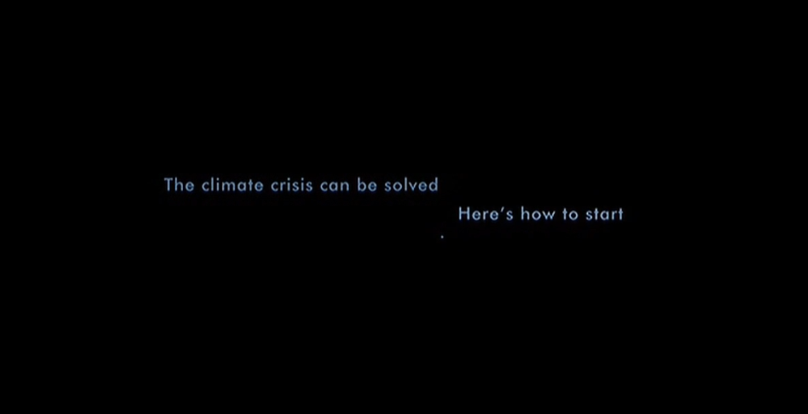
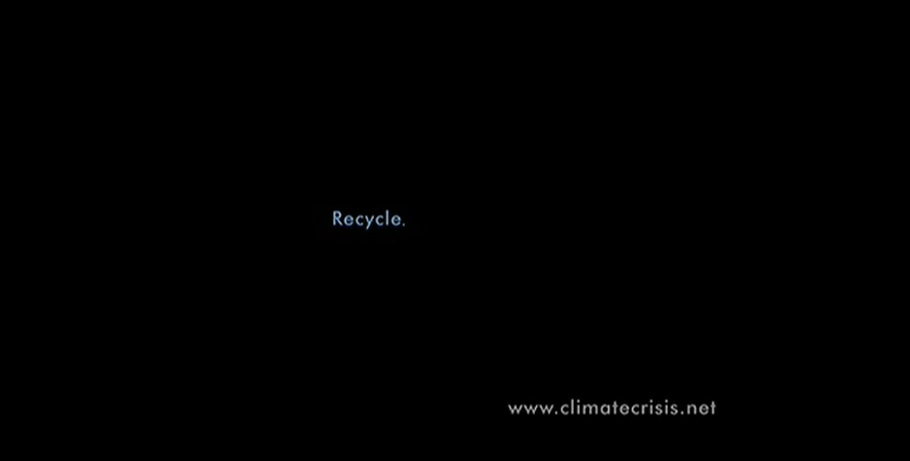
Motivation
Who’s seen An Inconvenient Truth?

Slide 5
Key Questions
How to nudge sustainable behaviour change?
Better to use “prosocial” motivation, “pro-self” motivation, or both together?
Better to make many questions for behaviour change, or focus on one?

Slide 6
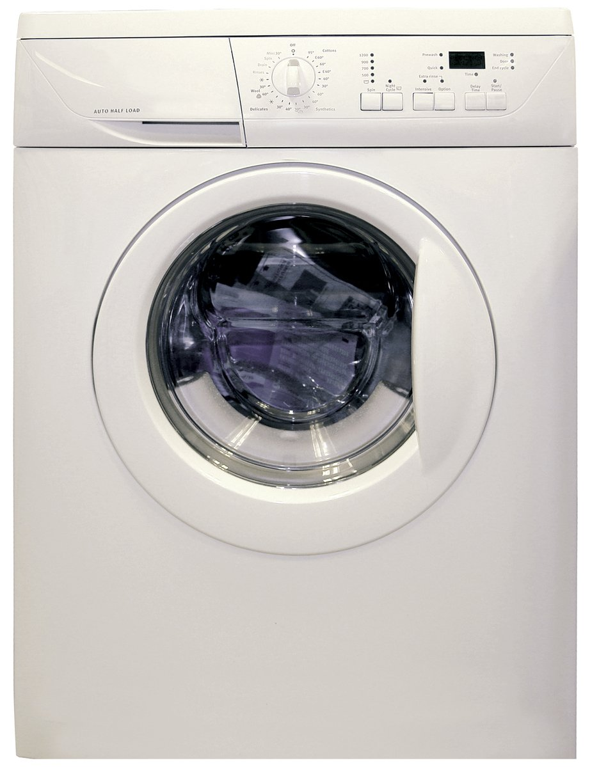
Practical Impact
Laundry represents about 19% - 28% of home energy use in houses using electric water heating, or 10-12% of household electricity in homes using natural gas water heating (BC Hydro calculations based on data from https://www.energystar.gov/ )
Little research on changing laundry behaviour
Identifiable via spikes in metered data (in theory)
Image credit: https://en.wikipedia.org/wiki/Clothes_dryer#/media/File:Clothes_Dryer.jpg
Notes:
Image source: https://www.freeimages.com/photo/washing-machine-1418432

Slide 7
Agenda
Literature review
Pilot surveys
Main study design
Hypotheses
Behavioural intention results
Self-report results
Behaviour logging results
Energy meter results
Summary & Conclusions
Notes:
Main study dates: June 2021 – May 2022

Slide 8
Literature Review

Slide 9
Literature Review
Short-term vs. long-term effects
Most “nudging” studies only examine a single choice
Dynamic energy competitions can be effective long-term (Schultz et al 2007; Wemyss et al., 2019), but only while the feedback is maintained
Defaults and auto-escalation are effective long-term (e.g., Benartzi & Thaler 2013)
Spillover effects
Meta-analysis shows positive spillover effects on intentions, but small negative effects on actual behaviour and policy support (Maki et al., 2019)
Single request vs multiple simultaneous requests??
Monetary vs. environmental motivation
Financial and environmental framing both improve energy efficient purchases, especially when scaled up (Camilleri & Larrick 2014; Hardisty et al. 2020; Ungemach et al 2018)
Financial and environmental messaging both improve energy saving intentions (Steinhorst, Klöckner, & Matthies, 2015; Steinhorst & Klöckner, 2018), but not actual behaviour (Steinhorst & Klöckner, 2018)

Slide 10
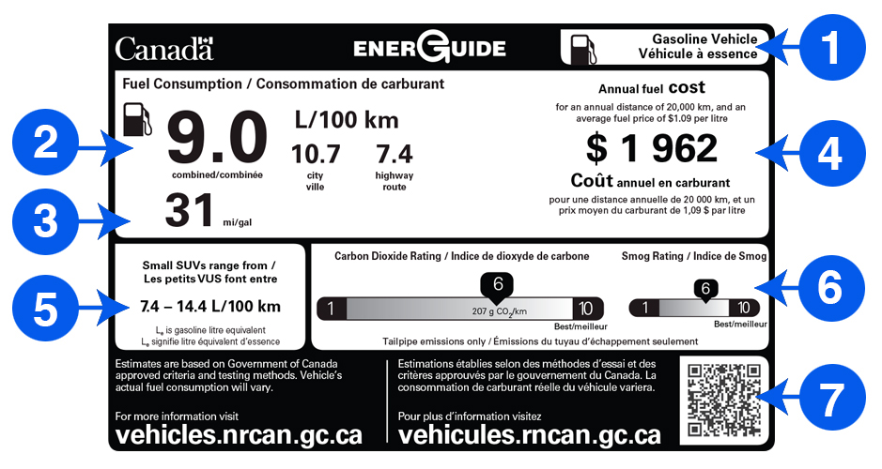
Literature Review
Image credit: https://www.nrcan.gc.ca/energy-efficiency/energuide-canada/energuide-vehicles/21010

Slide 11
Pilot Surveys

Slide 12
Pilot Surveys
Perhaps a decal on the laundry machine could provide a lasting nudge?
Constant reminder
Attractive
Low-cost
What‘s the right message?
Pilot surveys (Feb 2021 – Apr 2021) pre-tested ideas via six hypothetical scenarios via Prolific.co

Slide 13
Pilot Survey 2
600 Canadian participants on Prolific assigned to one of 13 conditions
Between-participants design: 2 (gain vs. loss framing) x 2 (time horizon: per load vs 10-year) x 3 (motivators: money vs. energy vs. both) + control
DVs: Willingness to engage in conservation behaviour (1=Not at all likely, 5=Very likely): - Rewear clothes until dirty - Combine small loads into large loads - Wash laundry in cold water - Hang dry laundry inside or outside

Slide 14
Pilot Surveys – Survey 2
Money-gain 10-year condition

Slide 15
Pilot Surveys – Survey 2
Money-loss 10-year condition

Slide 16
Pilot Surveys – Survey 2
CO2-gain 10-year condition

Slide 17
Pilot Surveys – Survey 2
CO2-loss 10-year condition

Slide 18
Pilot Surveys – Survey 2
Combined Money-Gain + CO2-Gain Condition

Slide 19
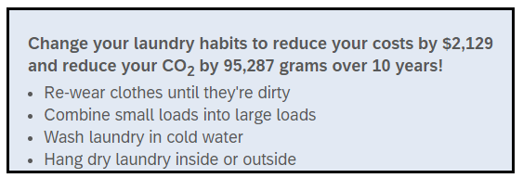
Pilot Surveys – Survey 2
Combined Money-Loss + CO2-Loss Condition

Slide 20
Pilot Surveys – Survey 2 Design Summary
Money-gain condition
CO2-gain condition
Money+ CO2-gain condition
Money-loss condition
CO2-loss condition
Money+ CO2-loss condition
Willingness to place decal (1= Definitely not, 5=Definitely yes): “Would you be willing to place a removable decal or sticker with this message on your washer or dryer?”
Willingness to engage in conservation behaviour (1=Not at all likely, 5=Very likely): “Rewear clothes until dirty, Combine small loads into large loads, Wash laundry in cold water, Hang dry laundry inside or outside”

Slide 21
Pilot Survey 2
Which condition do you predict was most effective in Pilot Survey 2?
Control
Money Gain
Money Loss
CO2 Gain
CO2 Loss
Money + CO2 Gain
Money + CO2 Loss
Null results

Slide 22
Pilot Survey 2
None of the interventions were significantly more effective than control
Fishing: The combined motivation condition (money + environment incentives) was marginally more effective than money or environment incentive alone in driving cold water washing intentions (p = .067).
Takeaway: Providing financial & climate information is not a strong motivator to change laundry behaviours

Slide 23
Pilot Survey 4
In qualitative pilot, most people said they care about their clothing, but not microplastics
Perhaps a novel motivation (microplastics) would be effective?
Vivid imagery might help?

Slide 24
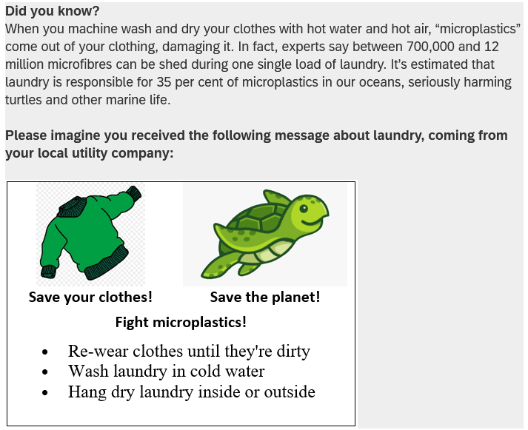
Pilot Survey 4

Slide 25
Two pilots later…

Slide 26
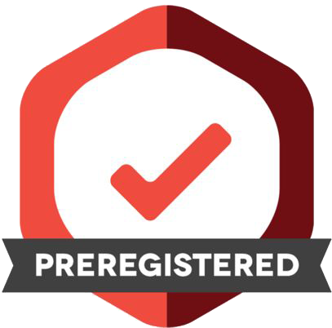
Main Study Design
Pre-registration: https://aspredicted.org/WWZ_WQ3

Slide 27
Study Design: Participants
1,210 BC Hydro customers recruited from BC Hydro’s Team Power Smart program and completed the first survey
Follow-up surveys every 3 months, for 1 year total
Must have Washing Machine & Clothes Dryer and pay BC Hydro bill
64% women, mean age = 57
Research questions:
Long term impact of decal nudge?
Pro-environment message, pro-self, or both?
Request many behavior changes, or just one hard one?
Notes:
Note: 1,647 agreed to participate in advance, but only 1,158 completed the time 1 survey, mostly due to blocked emails from Microsoft-related email addresses (such as @hotmail, @outlook, @msn, and @live email addresses) blocking our emails.

Slide 28
Target Laundry Behaviours
Re-wear
Combine loads
Use cold water
Hang dry clothes

Slide 29
Study Design: Overview
Independent Variable: Participants randomly assigned to one of six conditions
Control (no decal)
Control (QR logging decal)
Turtle appeal to change 4 behaviours
Fleece appeal to change 4 behaviours
Turtle + fleece appeal to change 4 behaviours
Turtle + fleece appeal to hang dry
Dependent Variables:
Laundry behaviour change intentions to re-wear, combine loads, cold water, hang-dry
Retrospective self-report of efficiency behaviours, every 3 months for one year
Ongoing log of laundry behaviour for one year
Energy meter data (hourly level) for one year, including 1-year prior history

Slide 30
Control (no decal)

Slide 31
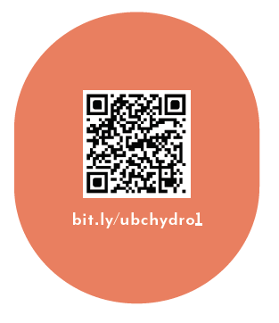
Control (logging decal only)
As part of your participation in this study, we will mail you a decal to put on your washer or dryer, which will look like the following:

Slide 32
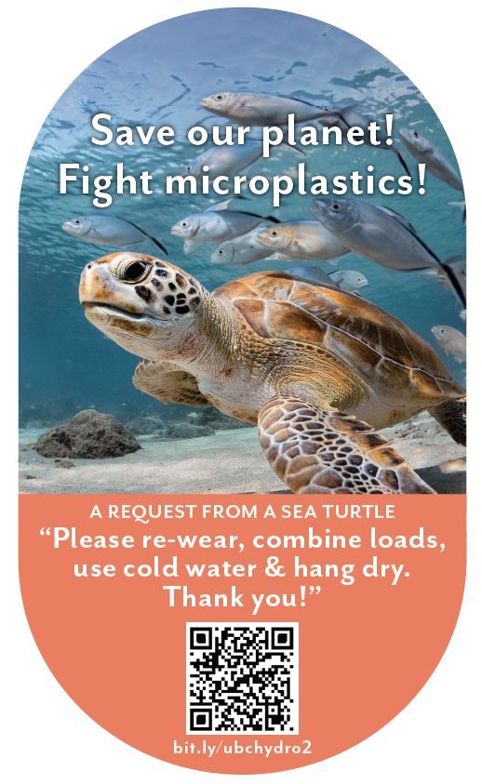
Sea Turtle + Bundled
When you machine wash and dry your clothes with hot water and hot air, “microplastics” come out of your clothes. In fact, experts say that between 700,000 and 12 million microfibres can be shed during one single load of laundry. It is estimated that laundry is responsible for 35% of microplastics in our oceans, seriously harming sea turtles and other marine life. You can save our planet by: - Re-wearing clothes more often - Combining loads to run fewer, larger loads of laundry - Washing laundry with cold water, rather than hot water or warm water - Hanging clothes to dry (inside or outside), rather than machine-drying clothes As part of your participation in this study, we will mail you a decal to put on your washer or dryer, which will look like the following:

Slide 33
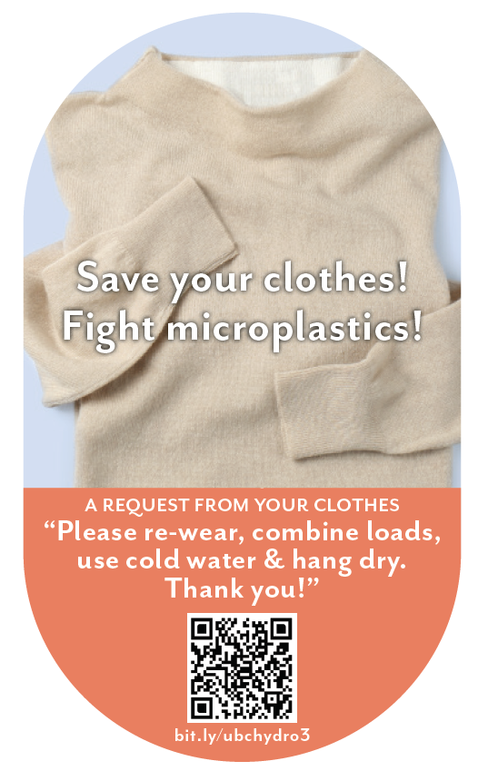
Clothing + Bundled
When you machine wash and dry your clothes with hot water and hot air, “microplastics” come out of your clothes. In fact, experts say that between 700,000 and 12 million microfibres can be shed during one single load of laundry. This breaks down the fabric in your clothes, damaging it and shortening the amount of time you’ll be able to enjoy wearing it. You can save your clothes by: - Re-wearing clothes more often - Combining loads to, run fewer, larger loads of laundry - Washing laundry with cold water, rather than hot water or warm water - Hanging clothes to dry (inside or outside), rather than machine-drying clothes
As part of your participation in this study, we will mail you a decal to put on your washer or dryer, which will look like the following:

Slide 34
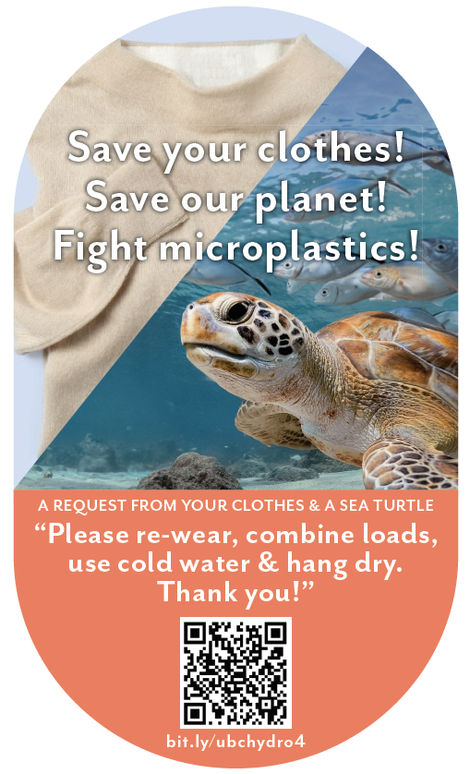
Turtle + Clothing + Bundled
When you machine wash and dry your clothes with hot water and hot air, “microplastics” come out of your clothes. In fact, experts say that between 700,000 and 12 million microfibres can be shed during one single load of laundry. This breaks down the fabric in your clothes, damaging it and shortening the amount of time you’ll be able to enjoy wearing it. It is also estimated that laundry is responsible for 35% of microplastics in our oceans, seriously harming sea turtles and other marine life. You can save your clothes and save our planet by: - Re-wearing clothes more often - Combining loads to, run fewer, larger loads of laundry - Washing laundry with cold water, rather than hot water or warm water - Hanging clothes to dry (inside or outside), rather than machine-drying clothes As part of your participation in this study, we will mail you a decal to put on your washer or dryer, which will look like the following:

Slide 35
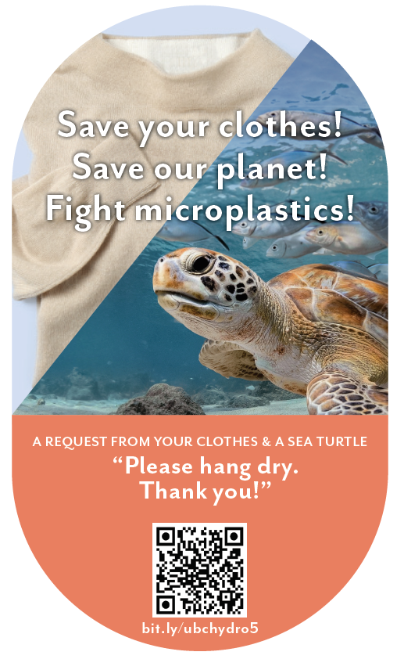
Turtle + Clothing + Hang Dry
When you machine wash and dry your clothes with hot water and hot air, “microplastics” come out of your clothes. In fact, experts say that between 700,000 and 12 million microfibres can be shed during one single load of laundry. This breaks down the fabric in your clothes, damaging it and shortening the amount of time you’ll be able to enjoy wearing it. It is also estimated that laundry is responsible for 35% of microplastics in our oceans, seriously harming sea turtles and other marine life.
You can save your clothes and save our planet by: - Hanging clothes to dry (inside or outside), rather than machine-drying clothes As part of your participation in this study, we will mail you a decal to put on your washer or dryer, which will look like the following:

Slide 36
Intentions Results

Slide 37
Intentions to engage in efficient laundry behaviours
Label | Cold Water | Rewear | Combine Load | Hang Dry | Average
Control (n=217) | 3.35 | 3.24 | 3.27 | 3.53 | 3.34
QR Scan Only Control (n=185) | 3.25 | 3.10 | 3.19 | 3.44 | 3.25
Sea turtle + bundled msg (n=189) | 3.61₁ ₂ | 3.47₁ ₂ | 3.46₁ ₂ | 3.60 | 3.53₁ ₂
Fleece + bundled msg (n=200) | 3.58₁ ₂ | 3.52₁ ₂ | 3.48₁ ₂ | 3.61₂ | 3.55₁ ₂
Sea turtle + fleece + bundled msg (n=184) | 3.60₁ ₂ | 3.42₁ ₂ | 3.40₁ ₂ | 3.54 | 3.49₁ ₂
Sea turtle + fleece + hang dry msg (n=189) | 3.56₁ ₂ | 3.42₁ ₂ | 3.38₂ | 3.77₁ ₂ | 3.53₁ ₂
Note: Participants answered on a 1-5 scale from 1=“much less often” to 3=“the same” to 5=“much more often”. Subscripts indicate significant difference from control (1) or QR scan only control (2).

Slide 38
Intentions to engage in efficient laundry behaviours
Summary:
All decals increased intentions to improve behaviours
Roughly equally effective on intentions

Slide 39
Summary: Decal Effectiveness vs Control
Condition | Intentions | Self-report | Logged Washing | Logged Drying | Metered Washing | Metered Drying
Turtle + Bundle | ✓
Fleece + Bundle | ✓
Turtle + Fleece + Bundle | ✓
Turtle + Fleece + Hang Dry | ✓

Slide 40
Self-report Results

Slide 41
Self-report Results
Takeaway:
From S1 to S4, participants were marginally less likely to report engaging in laundry efficient behaviours for the control conditions (ps <.1). “Sea turtle+fleece+hang dry” message and “Sea turtle+bundled” message were marginally more effective than control conditions at S4 (ps <.1)

Slide 42
Self-report Results
Takeaway:
From S1 to S4, participants were marginally less likely to report engaging in laundry efficient behaviours for the control conditions (ps <.1). “Sea turtle+fleece+hang dry” message and “Sea turtle+bundled” message were marginally more effective than control conditions at S4 (ps <.1)

Slide 43
Self-report of efficient laundry behaviours
Summary:
Two decal messages marginally improved self-reported behaviours over time: Microplastics turtle + bundled msg and Microplastics turtle + fleece+hang-dry msg

Slide 44
Summary: Decal Effectiveness vs Control
Condition | Intentions | Self-report | Logged Washing | Logged Drying | Metered Washing | Metered Drying
Turtle + Bundle | ✓ | †
Fleece + Bundle | ✓
Turtle + Fleece + Bundle | ✓
Turtle + Fleece + Hang Dry | ✓ | †

Slide 45
Behaviour Logging Results

Slide 46
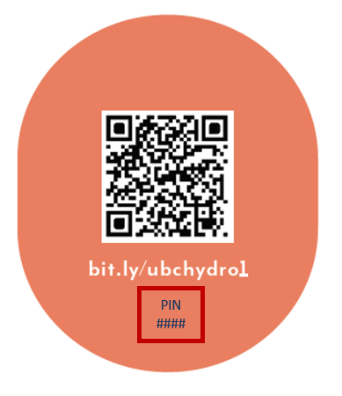
Behaviour Logging Results: QR Code Usage
 | Number | %
Via URL | 12,485 | 32%
Via QR Code | 26,460 | 68%
Total | 38,945 | 100%

Slide 47
Behaviour Logging Page

Slide 48
Behaviour Logging Results
Condition | n | Total Washed | Total Dried | Ratio (Dried / Washed)
Control (Decal) | 137 | 72.6 | 56.4 | 0.77
Turtle + Bundle | 125 | 50.2*** | 34.9*** | 0.68*
Clothes + Bundle | 113 | 67.5 | 51.8 | 0.75
Turtle + Clothes + Bundle | 109 | 63.4 | 46.1† | 0.73
Turtle + Clothes + Hang Dry | 127 | 64.2 | 39.4** | 0.63***
Symbols indicate significant differences from control. † p < .1, ** p < .01, *** p < .001
Notes:
These are the total numbers reported across the year. However, we only made logging “mandatory” for the first six months. Furthermore, man loads may not have been logged. The average across the year comes out to 1.2 laundry loads logged per week, and 0.9 drier loads logged per week. This is far below BC Hydro’s Residential End Use Study, which indicates the average # of washer loads (across all households and housing types) is 3.7 per week and the average # of dryer loads is 3.5 per week. The difference is likely due to a combination of self-selection and self-report issues. The ratio of machine dried loads to washed loads is probably the most reliable measure, avoiding self-report effects (but not self-selection effects).

Slide 49
Logging of efficient laundry behaviours
Summary:
Two decal messages improved logged behaviours over time: Microplastics turtle + bundled msg decreased washing and drying and Microplastics turtle + fleece+hang-dry msg decreased drying

Slide 50
Summary: Decal Effectiveness vs Control
Condition | Intentions | Self-report | Logged Washing | Logged Drying | Metered Washing | Metered Drying
Turtle + Bundle | ✓ | † | ✓ | ✓
Fleece + Bundle | ✓
Turtle + Fleece + Bundle | ✓
Turtle + Fleece + Hang Dry | ✓ | † |  | ✓

Slide 51
Energy Meter Results

Slide 52
Energy Meter Results: kWh per Day across all participants
Condition | Pre | Post | Change
Control (No survey) | 22.74 | 23.36 | 0.62
Control (No decal) | 21.21 | 21.54 | 0.32
Control (QR decal) | 22.93 | 23.14 | 0.21
Turtle + Bundle Msg | 23.02 | 23.79 | 0.77
Fleece + Bundle Msg | 22.04 | 22.77 | 0.72
Turtle + Fleece + Bundle Msg | 21.26 | 22.16 | 0.9
Turtle + Fleece + Hang Dry Msg | 22.06 | 22.54 | 0.48
NOTE: No significant differences across conditions
Notes:
The average household electricity consumption kWh per day is 28.9 kWh in the USA
The Texas average kilowatt usage per day is 39.2 kWh
https://electricityplans.com/kwh-kilowatt-hour-can-power/

Slide 53
Energy Meter Results: kWh for logging participants
Condition | n | Total Energy | Wash Energy | Dry Energy | Ratio (Dry/Wash)
Control (Decal only) | 94 | 15,168 | 139 | 121 | 0.81
Turtle + Bundle Msg | 91 | 14,704 | 105† | 79* | 0.68**
Fleece + Bundle Msg | 98 | 15,778 | 141 | 121 | 0.8
Turtle + Fleece + Bundle Msg | 72* | 14,240 | 102† | 82* | 0.79
Turtle + Fleece + Hang Dry Msg | 92 | 14,410 | 122 | 86* | 0.69**
Symbols indicate significant differences from control. † p < .1, * p < .05, ** p < .01

Slide 54
Metered efficient laundry behaviours
Summary:
No significant change in total energy usage, but data is noisy
When isolating laundry times, two conditions were effective: Turtle + bundled msg Turtle + fleece + hang dry
(Turtle + fleece + bundled msg also possibly effective, but looks like self-selection issues)

Slide 55
Summary: Decal Effectiveness vs Control
Condition | Intentions | Self-report | Logged Washing | Logged Drying | Metered Washing | Metered Drying
Turtle + Bundle | ✓ | † | ✓ | ✓ | † | ✓
Fleece + Bundle | ✓
Turtle + Fleece + Bundle | ✓ |  |  |  | †
Turtle + Fleece + Hang Dry | ✓ | † |  | ✓ |  | ✓

Slide 56
Study Summary & Conclusions

Slide 57
Conclusions
In the context of a motivated sample of BC laundry doers, over a period of one year:
Decals can be an effective nudging tool for sustaining energy efficient behaviour over time; serves as a constant reminder & motivation; attractive image is important; could be extended to other behaviours
Intentions often do not translate into real behaviour change
Changes in laundry behaviours were not detectable in total household energy usage, perhaps due to negative spillover/licensing

Slide 58
Conclusions
Most effective: combining a single, novel motivator (microplastics turtle) with multiple behaviour change requests
Not so effective in this context: self-interest (clothing, money), climate impacts
Sometimes energy motivations are not the best way to change energy behaviours
Not all environmental motivators are the same

Slide 59
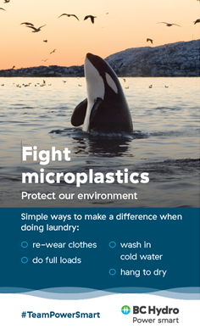
The Implemented Version

Slide 60
Thank You!

Slide 61
Questions?

Slide 62
References
Benartzi, S., & Thaler, R. H. (2013). Behavioral economics and the retirement savings crisis. Science, 339(6124), 1152-1153
Camilleri, A. R., & Larrick, R. P. (2014). Metric and scale design as choice architecture tools. Journal of Public Policy & Marketing, 33(1), 108-125.
Hardisty, D. J., Shim, Y., Sun, D., & Griffin, D. W. (2020). Encouraging energy efficiency: Product labels activate temporal tradeoffs. Available at SSRN 3576266.
Maki, A., Carrico, A. R., Raimi, K. T., Truelove, H. B., Araujo, B., & Yeung, K. L. (2019). Meta-analysis of pro-environmental behaviour spillover. Nature Sustainability, 2(4), 307-315
Schultz, P. W., Nolan, J. M., Cialdini, R. B., Goldstein, N. J., & Griskevicius, V. (2007). The constructive, destructive, and reconstructive power of social norms. Psychological science, 18(5), 429-434.
Steinhorst, J., Klöckner, C. A., & Matthies, E. (2015). Saving electricity–For the money or the environment? Risks of limiting pro-environmental spillover when using monetary framing. Journal of Environmental Psychology, 43, 125-135.
Steinhorst, J., & Klöckner, C. A. (2018). Effects of monetary versus environmental information framing: Implications for long-term pro-environmental behavior and intrinsic motivation. Environment and Behavior, 50(9), 997-1031.
Ungemach, C., Camilleri, A. R., Johnson, E. J., Larrick, R. P., & Weber, E. U. (2018). Translated attributes as choice architecture: Aligning objectives and choices through decision signposts. Management Science, 64(5), 2445-2459.
Wemyss, D., Cellina, F., Lobsiger-Kägi, E., De Luca, V., & Castri, R. (2019). Does it last? Long-term impacts of an app-based behavior change intervention on household electricity savings in Switzerland. Energy Research & Social Science, 47, 16-27.

